Slide 1
Background of the analysis
The objective of the analysis was to provide insights about which are the London Boroughs that have experienced the highest average increase in housing prices from year 1998 to 2018.
H
1
Methodology
Rows / missing values:
- count() on columns, missing data of Average Price and ID
- unique() on ID, 2 Unnamed and several non boroughs identified.
-unnamed: filter + check if they have data, they don’t → delete
- filter on all rows with average Price NaN.
- count() on columns, now all rows are popoulated.
- non Boroughs: made a list and filter df based on it to discard.
Visualization of data:
first visualization, line, x = Month, y = Average_price, too many rows
New column Year is created, applying lambda f(x) on month column
New df is created, with avg per year, cols using groupby: 3 columns now, Borough, Year and Average_Price
Index is reset so that is not Borough
The methodology we applied is the 4 stages of Data Science Pipeline:
Sourcing and Loading
Cleaning, transforming and visualizing
Modeling
Evaluating and Concluding
2
Criteria for success
To identify, quantitatively, which are the Boroughs that have experienced the highest increase in housing prices, from years 1998 to 2018.
3
Sourcing and Loading
The data source is the London Data Store (Open Source).
The data format is an excel file, with several sheets. We will work with information contained in sheet “Average price”
5
Modeling
Function created create_price_ratio meant to generate the ratio of average housing price increase per Borough
2 variables created for f(x) y1998 and y2018, to store the average price per Borough on each year.
Empty dict created to store the values of the upcoming loop
Loop runs on unique values of Borough and uses function to store ration in the dictionary
Dictionary converted to dataframe, transposed and columns renamed, 2 columns, Borough (Name) and 2018 (ratio info)
Values are sorted and and plot
4
Cleaning, Transforming and visualizing
In the following lines, we summarize the actions performed on the raw data to prepare it for the modeling stage, this is, that: (i) each variable has a column, and (ii) each observation forms a row.
Explore the data: 304 rows and 49 columns
Head of data: Boroughs in columns, Transpose applied.
Index: Boroughs are index, need to reset index applied.
Columns:
- index with integers, second row with dates is set as 1st row
- 2nd row is deleted (duplicated after previous amendment)
- names are added to Boroughs name and ID column
- melt used on id_vars Borough and ID, so 4 columns left.
- rename melted column (Month) and value columns (Average_price)
- data types of columns analysed, to_numeric to Average_price
Notes:
Hypothesis: Create a Hypothesis with an emphasis on SMART principles. (S – Specific, M – Measurable, A – Achievable, R – Realistic, T – Timebound). If you cannot do this, you do not have a good grasp on the business problem.
Context: With context, we have clearly identified the problem at hand and have elucidated on how our initiative may solve this problem, alongside the commercial implications this will have on the business.
Criteria for Success: Clearly defining the criteria for success ensures that the scope of your work is clearly defined and understood. Otherwise, if this isn’t defined – your work will never end which will result in mismatched expectations.
Scope of Solution Space: Scoping out the solution space ensures that the business initiative is SPECIFIC for a certain segment or area. This prevents solutions that have been developed being scaled and applied for all other business units that the solution may not be responsible or scalable for.
Constraints within Solution Space: Looking forward, what are the foreseeable problems we are likely to encounter? Could this be stakeholder resistance? Could this be we don’t have access to the right data?
Stakeholders to provide key insight: Who are the people I need to speak to, to get the answers I need for my data analysis?
What key data sources are required?
Based off my discussions with the key stakeholders – can we clearly list out all the data sources we need so we can make a highly targeted request as opposed to a scatter-gun approach where we ask for a bit of everything?

Slide 2
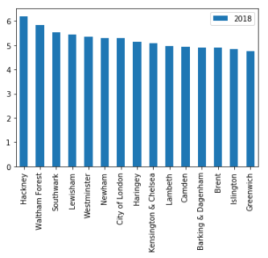
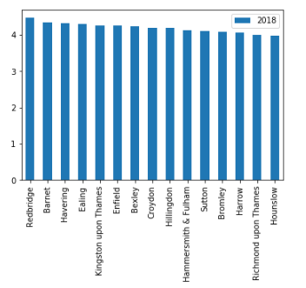
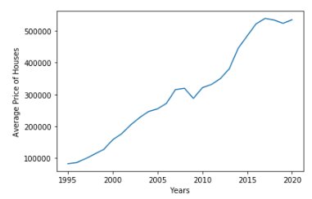
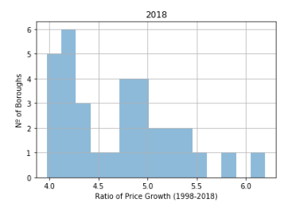
Deliverable Conclussions & Challenges
6
Conclusions from the analysis
- The distribution of growth ratio betwen Boroughs appears to be concentrated in ratios of 4.0 to 4.5, and between 4.75 and 5.4, which could be a sympthom that there is more than one population in the dataset.
Figure 1: Top 15 Boroughs based on ratio of growth in Housing Prices from 1998 to 2018
Figure 2: Bottom 15 Boroughs based on ratio of growth in Housing Prices from 1998 to 2018
The Boroughs that have experienced the highest increase are Hackney – Waltham Forest and Southwark.
The Boroughs that have experienced the lowest increase are Hounslow, Richmond upon Thames and Harrow.
Figure 4: Average Growth of price per year
- Based on Figure 4, there is a clear upward tren in housing prices. During 2008 and 2009, the main years of the financial crisis, there was a slight decrease, but after 2010 the prices have been growing.
Figure 3: Distribution of Ratio of Growth from 1998 to 2018 per Borough

